Slide 1
Group # 1 INTERFACING ULTRASONIC SENSORS WITH BEAGLEBONE BLACK
Submitted to – Prof. Mike Aleshams
Submitted by- Ramneet Kaur (C0752942)

Slide 2
LIST OF CONTENTS
Introduction to Project
Use of Ultrasonic Sensor in the Project
Pin Description of the Ultrasonic Sensor
Hardware and Software Requirements
Connection Diagram of Beaglebone Black with Ultrasonic Sensors.
Description of Connections
Circuit Connection of Beaglebone Black with Ultrasonic Sensors
Downloading and Installing IOBB library
Accessing GPIO pins of Beaglebone Black using IOBB Library in the Code.
Eclipse IDE for writing code
Overview of code
Results

Slide 3
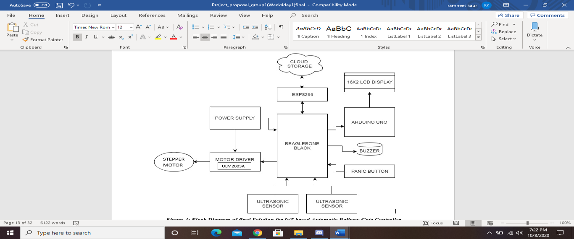
IoT based Automatic Railway Gate Controller

Slide 4
Use of Ultrasonic Sensors in the Project
The two Ultrasonic Sensors are used to detect Arrival and Departure of the Train.
The two ultrasonic sensors are placed at left and right side of the railway gate. The distance between the two sensors is dependent on the length of the train.
Ultrasonic sensors work on 5v supply from BBB.
The ultrasonic sensors are interfaced with Beaglebone Black over GPIO pins.

Slide 5
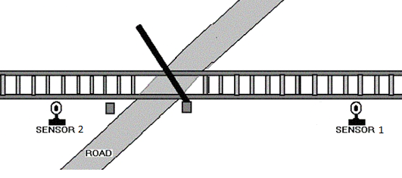
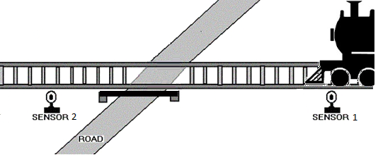
Continue..
The Beaglebone Black controls the following functioning of the Project based on data sensed from Ultrasonic Sensors:
First, if the sensor 1 detects the arrival of the train, BBB starts the motor with the help of motor driver in order to close the gate.
The gate remains closed as long as the train crossing the road.
When the train crosses the gate and reaches second sensor, it detects the train and the BBB will open the gate.

Slide 6
Continue…
Second, when the Sensor 1 detects the arrival of train, Beaglebone Black will update the status of the LCD and “Train Arrived” status will be shown on the LCD.
The Sensor 2 detects the departure of the train, then BBB will update the status of the LCD and “Train Departed” will be shown on the LCD.
Third, as per data sensed from both sensors, BBB will update data on the Thingspeak for record of higher authorities.

Slide 7
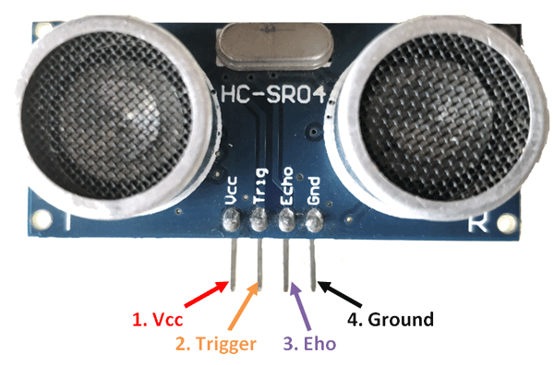
Pin Description of Ultrasonic Sensor
The Vcc pin powers the sensor, typically with +5V
Trigger pin is an Input pin. This pin is kept high for 10us to initialize measurement by sending US wave.
Echo pin is an Output pin. This pin goes high for a period which will be equal to the time taken for the US wave to return to the sensor.
Gnd pin is connected to the Ground of the BBB.

Slide 8
Hardware and software requirements
Hardware Requirements
Ultrasonic Sensors
Beaglebone Black
USB Cable
Connecting Wires
Breadboard
Software Requirements
Debian OS
Linux Operating System
Nano Editor
GCC compiler to run code
Eclipse IDE for Writing code

Slide 9
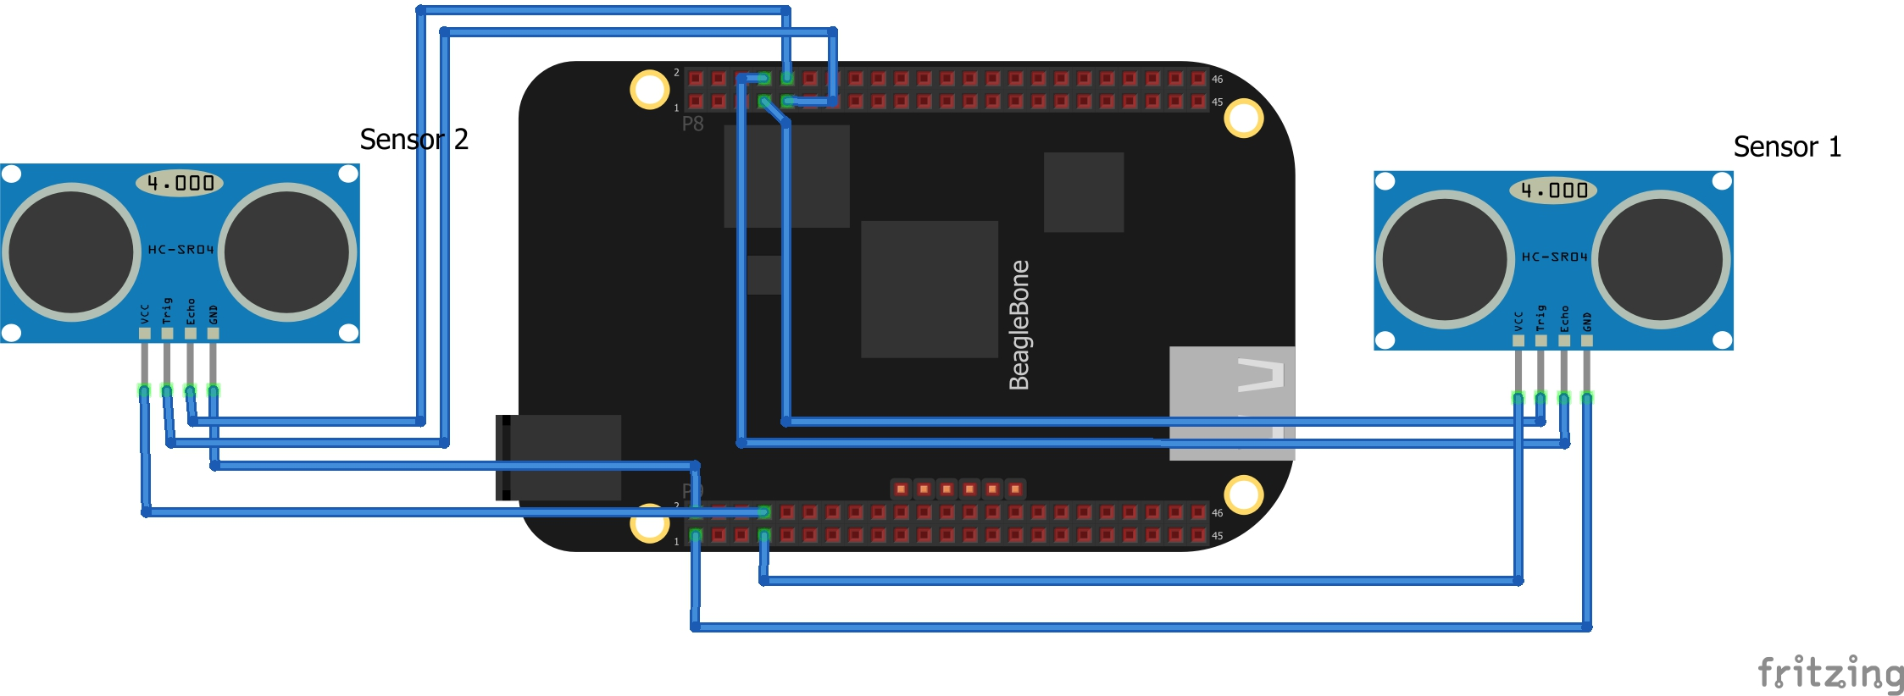
Connection diagram of Beagle bone Black with Ultrasonic Sensors

Slide 10
Description of Connections
Connecting Ultrasonic sensor 1 with BBB:
Connect ground pin of ultrasonic sensor with P9.1(GND) of BBB.
Connect with VCC pin of ultrasonic sensor with P9.7(SYS_5V).
Connect the Echo pin of ultrasonic sensor with P8.8 (GPIO_67) of BBB.
Connect the Trigger pin of ultrasonic sensor with P8.7(GPIO_66) of BBB.
Connecting Ultrasonic sensor 2 with BBB:
Connect ground pin of ultrasonic sensor with P9.2(GND) of BBB.
Connect with VCC pin of ultrasonic sensor with P9.8(SYS_5V).
Connect the Echo pin of ultrasonic sensor with P8.10 (GPIO_68) of BBB.
Connect the Trigger pin of ultrasonic sensor with P8.9 (GPIO_69) of BBB.

Slide 11
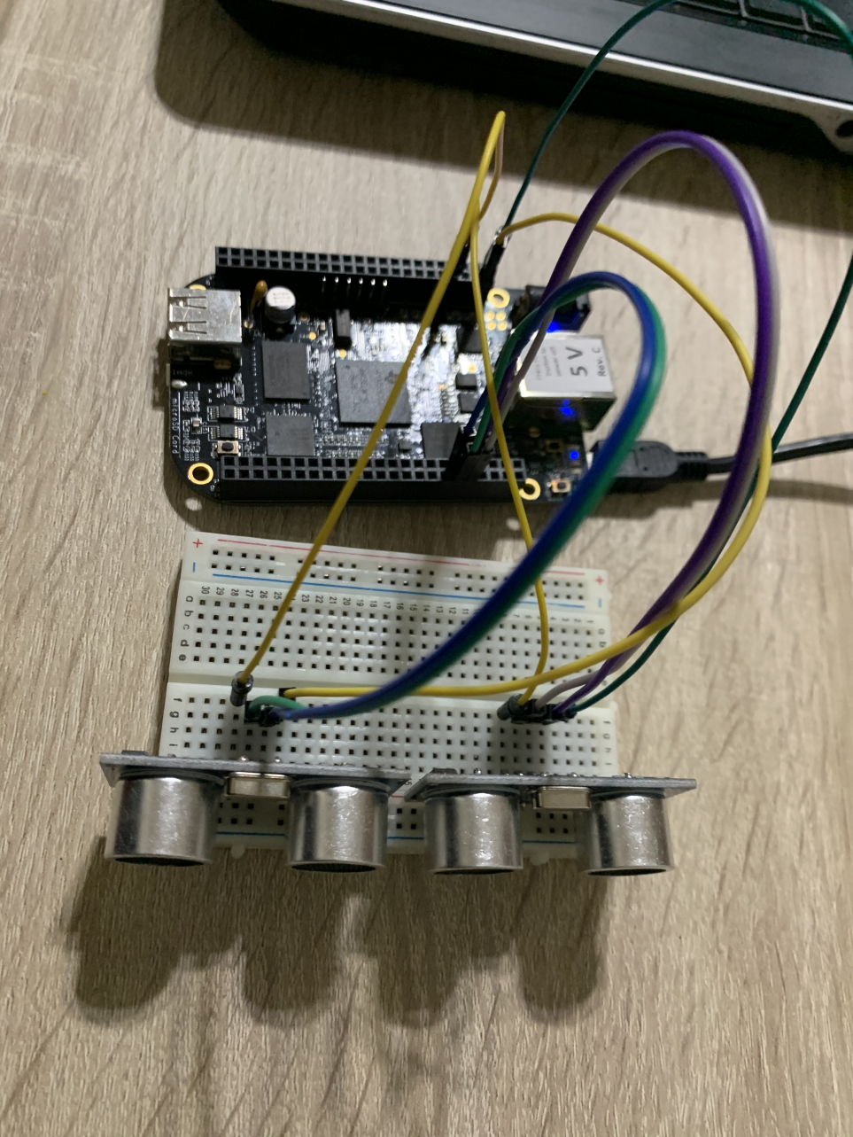
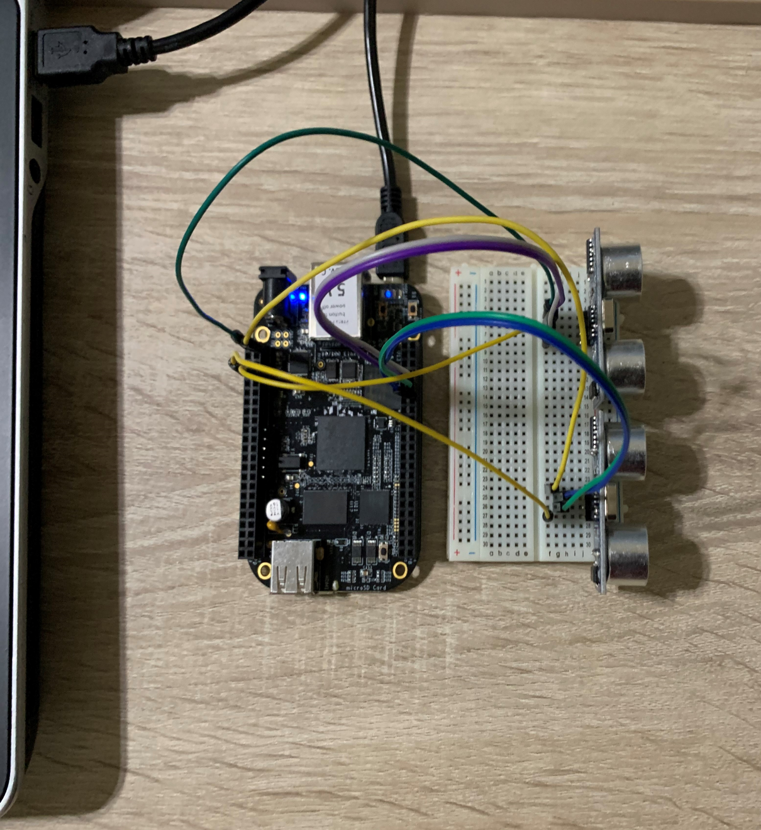
Circuit Connection of BBB With Ultrasonic Sensors

Slide 12
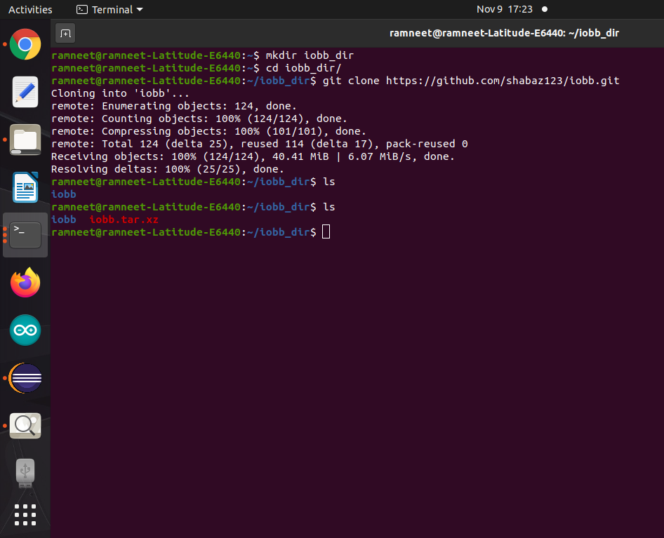
Downloading And Installing Iobb Library
IOBB library is used to access GPIO pins of the Beaglebone Black.
This library is specifically made for Beaglebone Black.
https://github.com/shabaz123/iobb
Make a development type folder and then the code can be downloaded and compiled:
mkdir iobb_dir
cd iobb_dir
git clone https://github.com/shabaz123/iobb.git

Slide 13
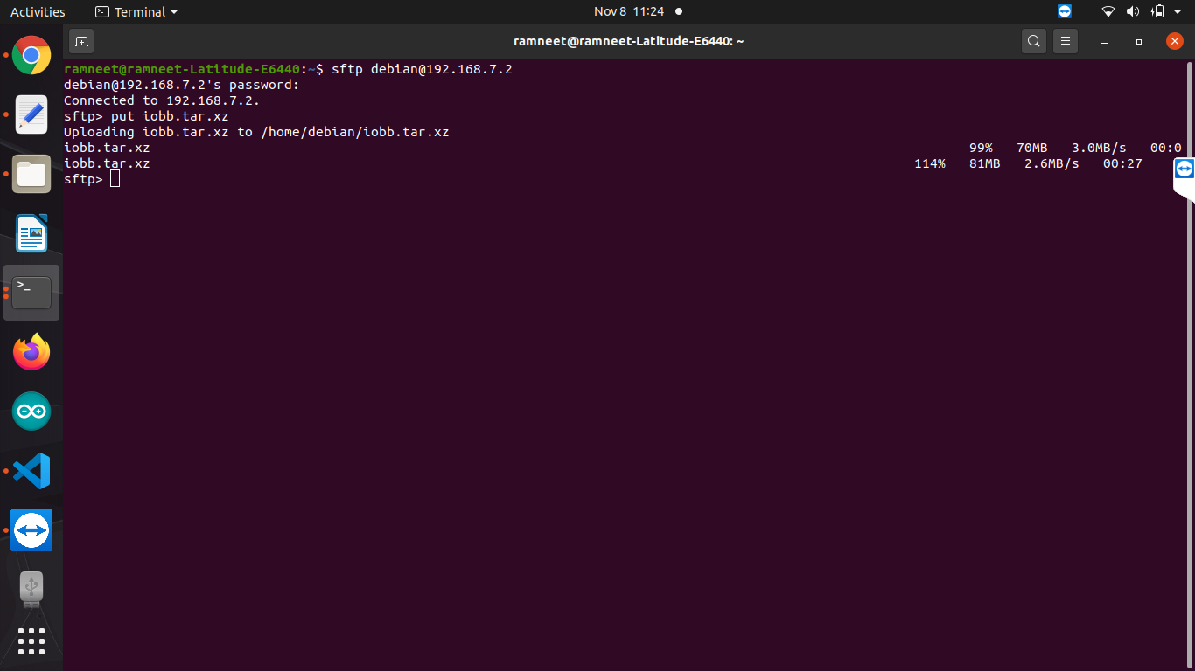
Continue...
After cloning the iobb folder on the host system (Linux), the folder in compressed into tar.xz and transferred to beagle bone using following commands:
Login as: sftp debian@192.168.7.2
Sftp > put iobb.tar.xz
Sftp> exit

Slide 14
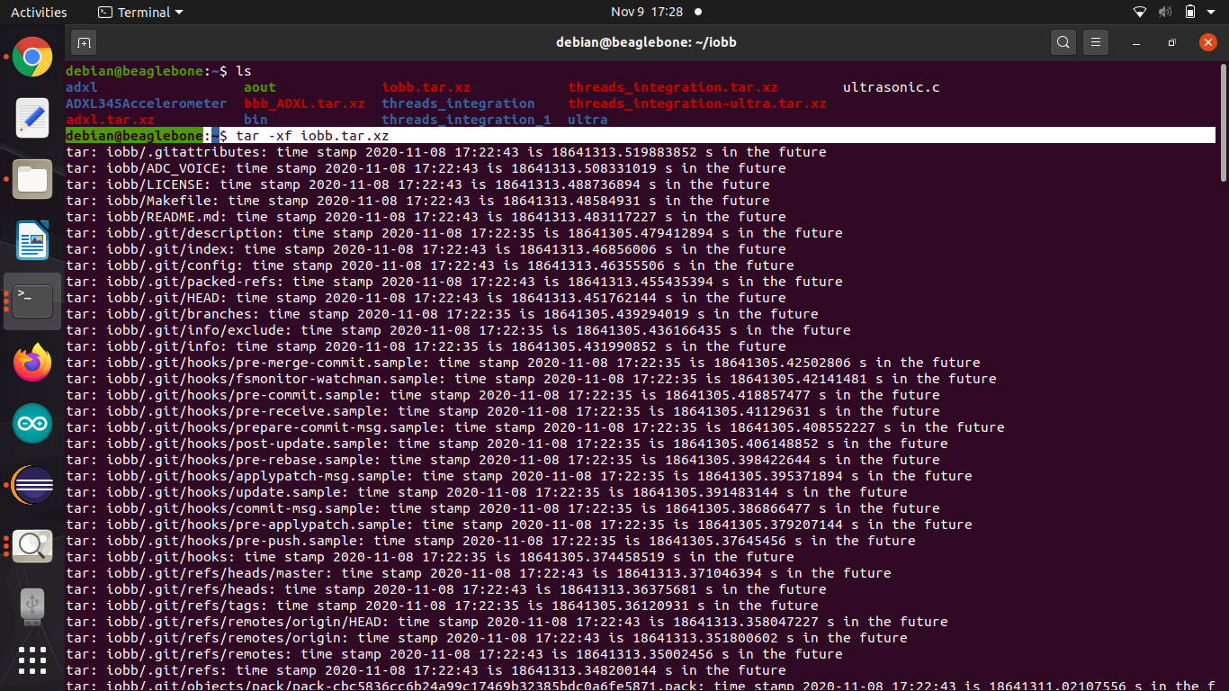
Continue...
After setting up BBB, log into your Beagle Bone Black.
Extract the tar.xz file in Beaglebone black using the command:
tar –xf iobb.tar.xz

Slide 15
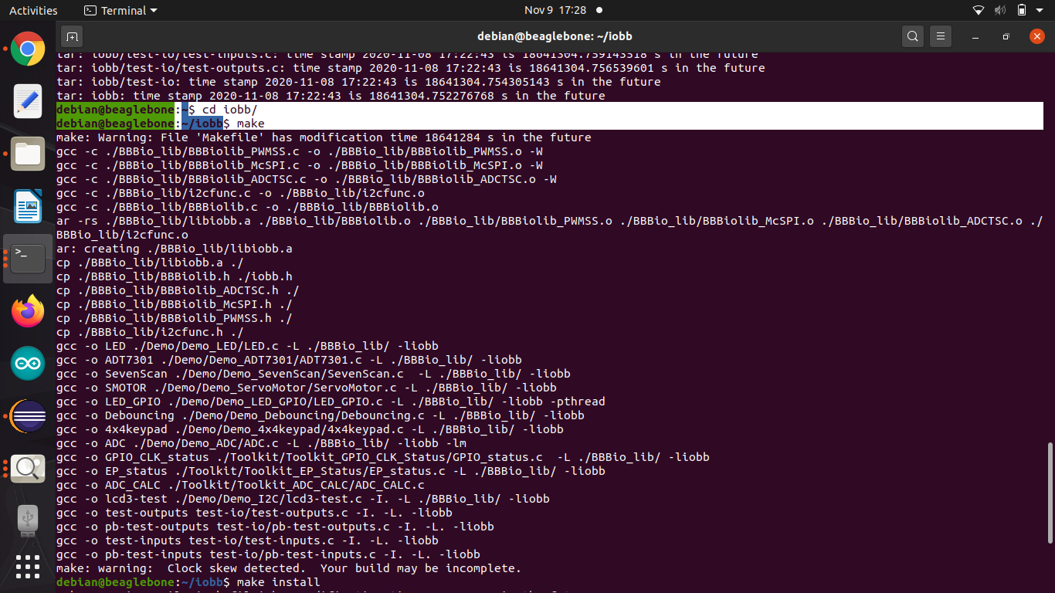
Continue...
To install iobb library in beaglebone Debian OS, the following commands are used:
cd iobb
make
make install, run this command as root user (sudo)

Slide 16
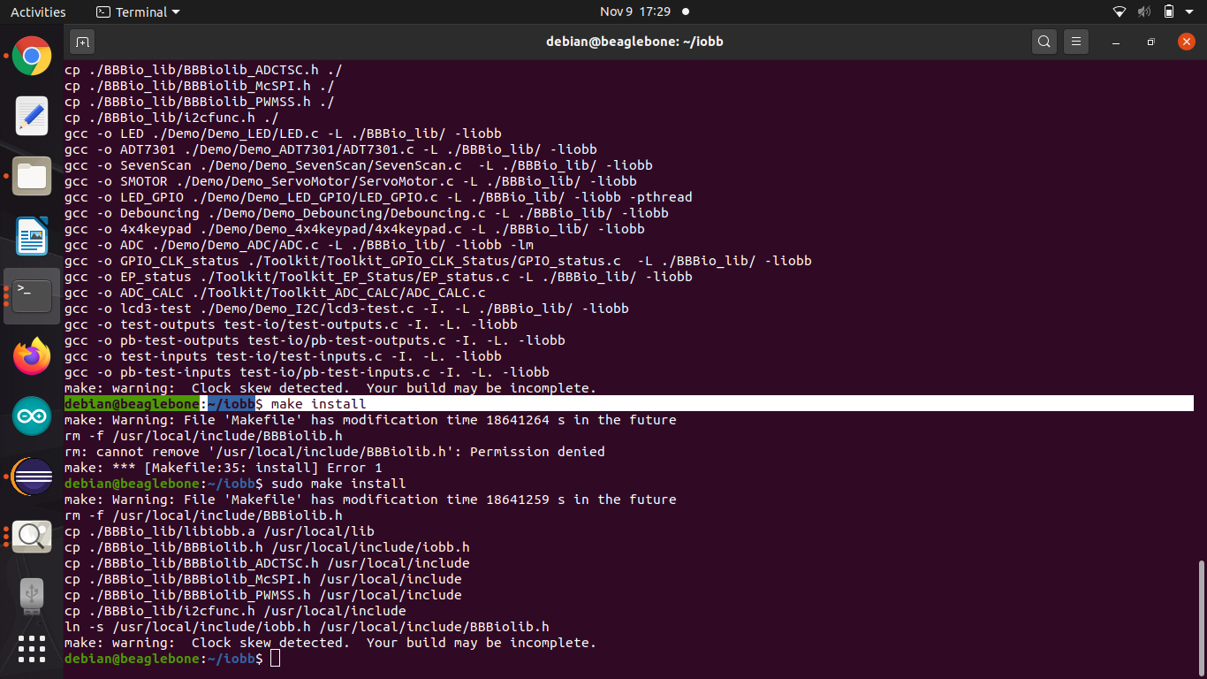
Continue..

Slide 17
Accessing GPIO pins of BBB using IOBB Library in the code
If header file is included in C source code: #include <iobb.h>
Then, it is possible to access GPIO input/output. The first step in the code is to initialize the library using this function : iolib_init();
Example:
To set a GPIO pin to be used as an input or output, use these commands (the first digit is 8 or 9 to represent the port P8 or P9, and the second digit is the physical pin number of that port):
iolib_setdir(8, 12, DigitalIn);
iolib_setdir(8, 12, DigitalOut);
At the end of the program, the library resources are freed up using:
iolib_free();
To write to an output pin using these commands:
pin_high(8, 12);
pin_low(8, 12);

Slide 18
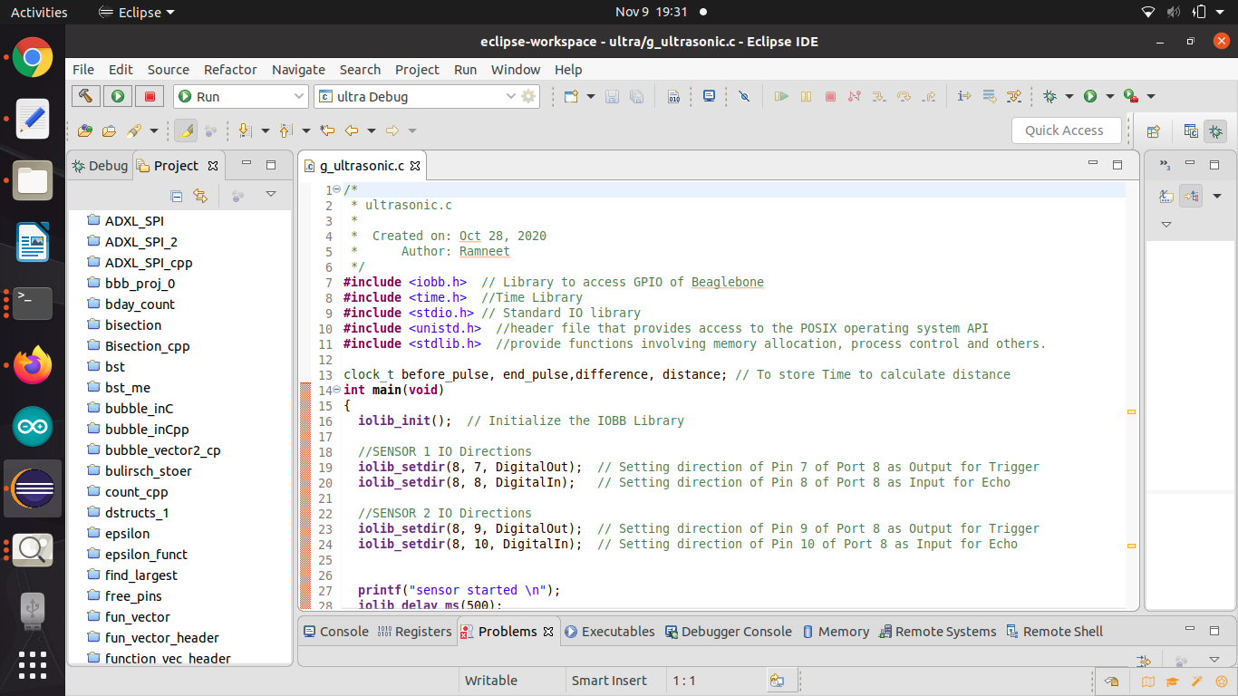
Eclipse IDE for writing code
The project is written and compiled in Ecpilse IDE.
In this project, we controlled the GPIO pins through iobb.h library and interfaced ultrasonic sensors with GPIO pins of Port 8, PIN 7,8,9 and 10.

Slide 19
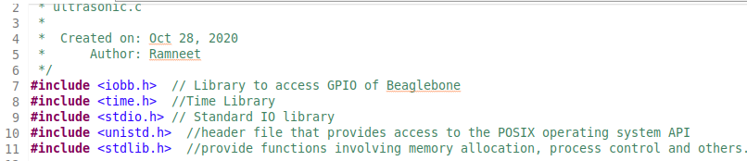
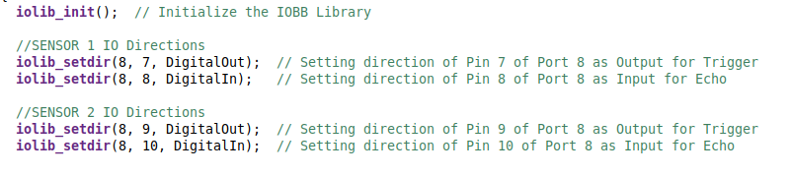
Overview of the code
The following libraries are included in the main code:
iobb. h library is used to access GPIO pins
time.h library is used to calculate distance of object from sensor.
stdio.h is standard input and output library
unistd.h is included for usleep function.
stdlib.h is for memory allocation and process control
In the main ( ) function:
1. First step is to initialize iobb library and set the direction of I/O Pins:
Setting direction of Pin 7 of Port 8 as Output for Trigger for sensor 1
Setting direction of Pin 8 of Port 8 as Input for Echo sensor 1
Setting direction of Pin 9 of Port 8 as Output for Trigger for sensor 2 Setting direction of Pin 10 of Port 8 as Input for Echo for sensor 2

Slide 20
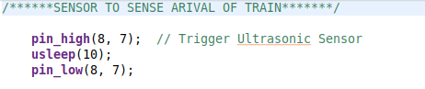
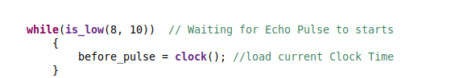
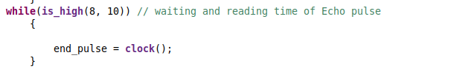
Continue..
In order to make sensor to sense the arrival of the Train, a high to low signal is given to the trigger pin with a small delay.
Echo pin is initially low, this time is recorded using clock( ) function in begin_pulse variable.
When the wave is reflected by striking an object(train here), then echo pulse will become high and this time is recorded in end_pulse variable.
The distance is calculated of the object by taking a difference in the above two variables.
The sound wave travel forward and gets reflected from the obstacle, so the calculated time difference is divided by 2
The distance is calculated in Centimeters = ((Microseconds / 2) / 30).

Slide 21
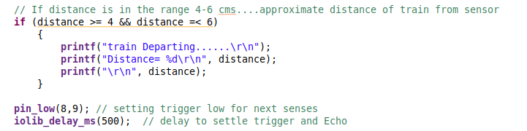
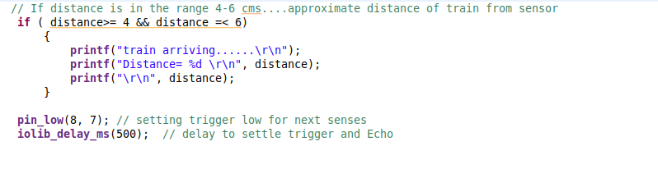
Continue..
If distance is in between 4 and 6 cms, then sensor 1 will detect the arrival of train and will print the status along with distance measured by the sensor.
Finally, the trigger pin is cleared, and the process is repeated under while loop.

Slide 22
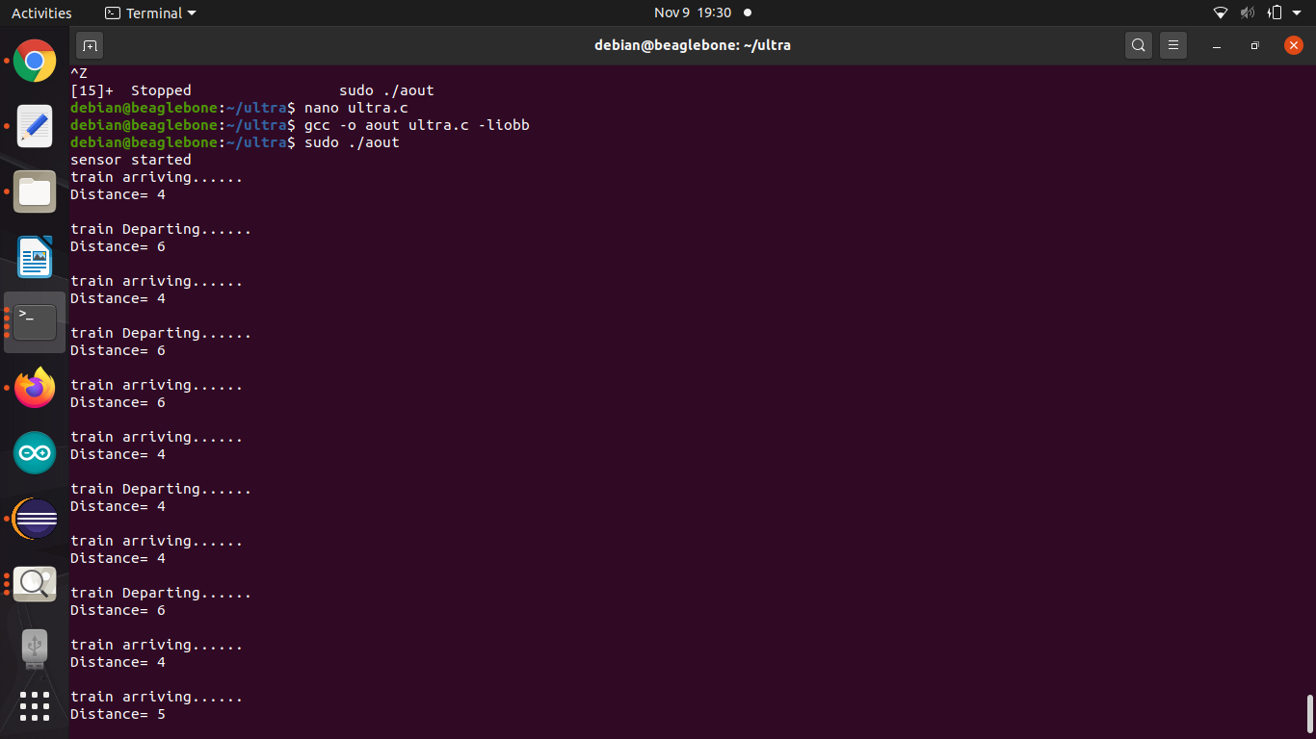
Results
If the obstacle is from 4 cm to 6 cm, then sensor 1 will detect the arrival of train and similarly for sensor 2 will detect departure of train if the distance is between 4 cm to 6 cm.

Slide 23
References
Component101. (2018, July 9). BeagleBone Black. Retrieved from https://components101.com/microcontrollers/beaglebone-black-pinout-datasheet
HC-SR04 Ultrasonic Senso. (2017, September 18). Retrieved from Component101: r https://components101.com/ultrasonic-sensor-working-pinout-datasheet#:~:text=Trigger%20pin%20is%20an%20Input,measurement%20by%20sending%20US%20wave.&text=This%20pin%20goes%20high%20for,return%20back%20to%20the%20sensor.
shabaz. (2019, August 14). BeagleBone Black (BBB) and PocketBeagle I/O (GPIO), SPI and I2C Library for C – 2019 Edition. Retrieved from Element14: https://www.element14.com/community/community/designcenter/single-board-computers/next-genbeaglebone/blog/2019/08/15/beaglebone-black-bbb-io-gpio-spi-and-i2c-library-for-c-2019-edition
Shabaz123. (n.d.). shabaz123/iobb. Retrieved from github.com: https://github.com/shabaz123/iobb
HC-SR04 Ultrasonic Distance Sensor Module. (n.d.). Retrieved from Banana Robotics: bananarobotics.com/shop/HC-SR04-Ultrasonic-Distance-Sensor#:~:text=To%20measure%20the%20distance%20the,a%20surface%20and%20returns%20back.

